Slide 1
SQL for Data Querying and Analysis
Week 2 Lecture

Slide 2
Agenda
Review
Joins (Inner, Left/Right, Full)
Sets (Union, Intercept, Except)

Slide 3
Review

Slide 4
Review!
SQL stands for Structured Querying Language and is used to communicate with databases
SQL queries can be made up of up to 6 clauses but only the select clause and from clause are required
The select clause determines which columns will be included in the query’s result
The from clause determines which tables to retrieve data from and how they should be joined together
The where clause filters out unwanted rows of data based on conditions
The group by clause allows us to manipulate our data via grouping or aggregation across common column values
The having clause filters out unwanted groups based on conditions
The order by clause sorts the output of the query by one or multiple columns

Slide 5
Anatomy of a SQL Query
SELECT
COLUMN_1, SUM(COLUMN_2)
FROM
TABLE_NAME
WHERE
COLUMN_1 = ‘VALUE’
GROUP BY
COLUMN_1
HAVING
SUM(COLUMN_2) > 10
ORDER BY
COLUMN_1;
Select Clause
From Clause
Where Clause
Group By Clause
Having Clause
Order By Clause

Slide 6
SQL Syntax Best Practices
Each column in select clause on its own line
SELECT
COLUMN_1
, SUM(COLUMN_2)
FROM
TABLE_NAME
WHERE
COLUMN_1 = ‘VALUE’
-- Filter data here
GROUP BY
COLUMN_1
HAVING
SUM(COLUMN_2) > 10
ORDER BY
COLUMN_1;
Put key words on their own line and indent lines with no key words (indents are key!)
Capitalize key words!
Use double dash (--) to comment your code
End query with a semi colon

Slide 7
Relational Databases

Slide 8
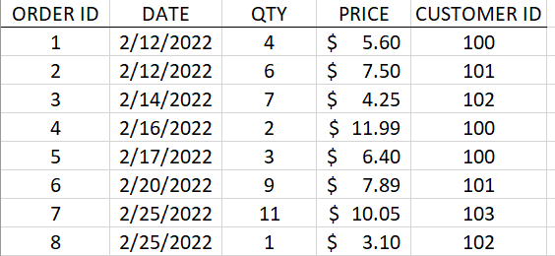
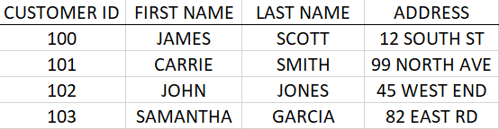
What are Relational Databases?
Relational databases store data in tables that are related to one another
They are key to understanding and writing effective SQL code!
Every row in every table has a unique key that identifies the row and can help relate the table to other tables in the database
Why not store data in a spreadsheet??
ORDERS TABLE
CUSTOMERS TABLE

Slide 9
Relational Database Concepts
Tables in relational databases can have primary keys and/or foreign keys
A primary key is a unique identifier within a table
A foreign key serves as a link to another table where the same values serve as a primary key
Primary Key
Foreign Key
ORDERS TABLE
CUSTOMERS TABLE

Slide 10
Joins

Slide 11
What is a Join?
A join is an operation that uses related columns between tables to combine data from multiple tables into one query
Joins typically leverage both a primary key and a foreign key
Joins are located in the from clause of a SQL query *
* There is an additional syntax for joins from version SQL92 that puts joins in the where clause, but this syntax is considered less flexible and less interpretable

Slide 12
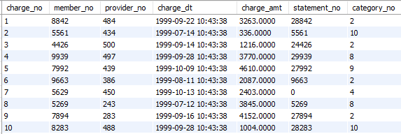
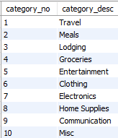
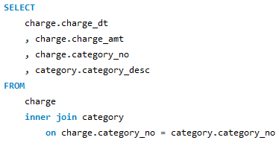
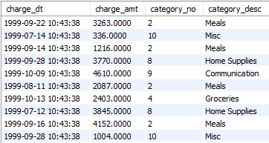
Join Example
Charge Table
Category Table
Query
Result

Slide 13
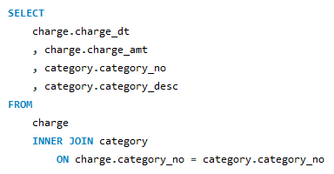
Anatomy of a Join
When joining multiple tables, columns in the select clause should include the source table as a prefix to specify to the server where to pull the column from and avoid ambiguity
Specify what kind of join you are performing (INNER) and what table you are joining in (category)
The ON subclause shows how tables are related by specifying their relationship between 1 or more keys

Slide 14
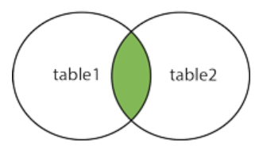
Inner Joins
An inner join return all records that have matching values in both tables
Inner joins can be useful for filtering to a subset of your data

Slide 15
Demo Set 2.1

Slide 16
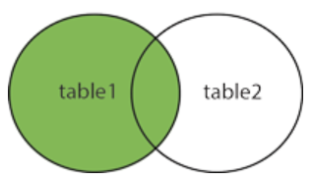
Left Join
A left join returns all rows from the left table specified in the join and only the matched records from the right table
Left table is responsible for determining number of rows in result set
Left joins are useful when you want to bring in data from other tables without sacrificing any rows (so very useful!)

Slide 17
Demo Set 2.2

Slide 18
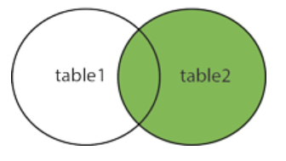
Right Join
A right join returns all rows from the right table specified in the join and only the matched records from the left table
Right table is responsible for determining number of rows in result set
While right joins function quite similarly to left joins, they are rarely used and are not supported by all database servers!

Slide 19
Demo Set 2.3

Slide 20
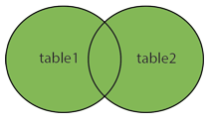
Full Joins
Not available in MySQL
Can be accomplished by a ‘UNION’ of a left join and right join of the two tables!
UNIONs coming up soon
Full Joins rarely used!

Slide 21
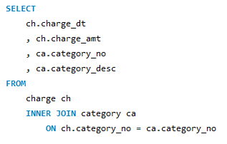
Using Table Aliases with Joins
Leveraging table aliases in your joins is a great way to keep them clean and interpretable
Table aliases are set in the from clause of a query

Slide 22
Demo Set 2.4

Slide 23
Pop Quiz!

Slide 24
Which query runs successfully?
A)
B)
SELECT
charge_no
, charge_amt
, statement_no
, statement_dt
FROM
charge
INNER JOIN statement
ON charge.statement_no = statement.statement_no;
SELECT
charge.charge_no
, charge.charge_amt
, charge.statement_no
, statement.statement_dt
FROM
charge
INNER JOIN statement
AS charge.statement_no = statement.statement_no;
C)
D)
SELECT
charge.charge_no
, charge.charge_amt
, charge.statement_no
, statement.statement_dt
FROM
charge
INNER JOIN ON statement
charge.statement_no = statement.statement_no;
SELECT
charge.charge_no
, charge.charge_amt
, charge.statement_no
, statement.statement_dt
FROM
charge
INNER JOIN statement
ON charge.statement_no = statement.statement_no;

Slide 25
Which query runs successfully?
A)
B)
SELECT
charge_no
, charge_amt
, statement_no
, statement_dt
FROM
charge
INNER JOIN statement
ON charge.statement_no = statement.statement_no;
SELECT
charge.charge_no
, charge.charge_amt
, charge.statement_no
, statement.statement_dt
FROM
charge
INNER JOIN statement
AS charge.statement_no = statement.statement_no;
C)
D)
SELECT
charge.charge_no
, charge.charge_amt
, charge.statement_no
, statement.statement_dt
FROM
charge
INNER JOIN ON statement
charge.statement_no = statement.statement_no;
SELECT
charge.charge_no
, charge.charge_amt
, charge.statement_no
, statement.statement_dt
FROM
charge
INNER JOIN statement
ON charge.statement_no = statement.statement_no;

Slide 26
Joining More than 2 Tables
SQL queries can include as many joins as needed to produce your desired result set
For every join in your query the table, join type and on subclause must be specified
Join order does not matter!
Regardless of order in your query the database server will select the optimal table to begin with and from there decide which joins to perform

Slide 27
Demo Set 2.5

Slide 28
Cross Joins
Cross Joins are used to generate a ‘Cartesian product’ of two tables
A ‘Cartesian product’ is every possible combination of 2 sets
While seldom used compared to other joins, they are an excellent tool to have for data prep

Slide 29
Sets

Slide 30
Sets
In addition to joins, sets (meaning sets of rows) and set operators are a great way to combine, filter, and manipulate your data across multiple sources
In order to leverage set operators each set must have the same number of columns and the same types for corresponding columns
Set operators: UNION (ALL), INTERSECT, and EXCEPT

Slide 31
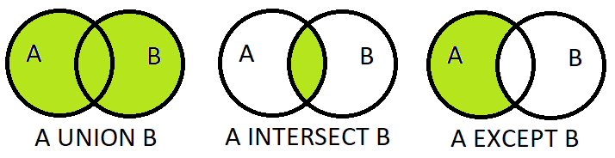
Set Operators
UNION keeps all rows from both sets and removes duplicates. UNION ALL keeps all rows from both sets without removing duplicates
INTERSECT keeps all rows that are present in both sets
EXCEPT keeps all rows that are present in the first set but are not present in the second set

Slide 32
Demo Set 2.6

Slide 33
Pop Quiz!

Slide 34
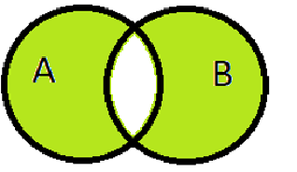
Using set operators, how would you filter to the green set of data:
A)
B)
(A UNION B) EXCEPT (A INTERECT B)
(A INTERSECT B) UNION (B INTERSECT A)
C)
(A EXCEPT B) UNION (B EXCEPT A)
D)
(A UNION B) EXCEPT (B EXCEPT A)

Slide 35
Using set operators, how would you filter to the green set of data:
A)
B)
(A UNION B) EXCEPT (A INTERECT B)
(A INTERSECT B) UNION (B INTERSECT A)
C)
(A EXCEPT B) UNION (B EXCEPT A)
D)
(A UNION B) EXCEPT (B EXCEPT A)

Slide 36
Review!
A primary key is a unique identifier within a table while a foreign key serves as a link to another table where the same values serve as a primary key
A join is an operation that uses related columns (primary/foreign) between tables to combine data from multiple tables into one query. Located in the from clause!
You can use joins to join more than 2 tables at a time (table aliases helpful here!)
Sets and set operators are a great way to combine, filter, and manipulate your data across multiple sources
Sets must have the same number of columns and the same types for corresponding columns

Slide 37
Resources to Practice
Code Academy SQL Course: https://www.codecademy.com/learn/learn-sql
SQL Zoo: https://sqlzoo.net/
W3 Schools: https://www.w3schools.com/sql/sql_exercises.asp

Slide 38
Thank You!

